Slide 1



Slide 4
Ei1400 fitting to theory on constant background https://github.com/abuts/Fe/blob/master/2018Dec/fit_cut_110_GH_Ei1400.m

Slide 5
Ei1400 fitting to theory no background

Slide 6
Ei1400 fitting to theory; background removed

Slide 7
Ei1400 comparing theory and the experiment. Background extracted https://github.com/abuts/Fe/blob/master/2018Dec/disp_GH_Ei1400.m
Mag-ff corrected in similar fashion both for theory and experiment
No resolution function convolution here.

Slide 8
Ei1400 comparing theory and the experiment. Background extracted. Symmetrized 4 cuts (fig below and the page1) https://github.com/abuts/Fe/blob/master/2018Dec/disp_GH_all_Ei1400.m

Slide 9
Ei1400 comparing theory and the experiment. Symmetrized 4 cuts
https://github.com/abuts/Fe/blob/master/2018Dec/fit_GH_all_Ei1400.m

Slide 10
Amplitude of fitting to theory and background (red) according to
different cuts in direction <100>
Results from this fit:
Combined fits in GH direction

Slide 11
Exploring Ei800 direction 110

Slide 12
Ei800 comparison with theory at different energies (bg removed) https://github.com/abuts/Fe/blob/master/2018Dec/cut_plot_edep110_Ei800.m
Dif between imgd left:

Slide 13
(no convolution)

Slide 14
Ei800 fitting to theory on constant background https://github.com/abuts/Fe/blob/master/2018Dec/fit_GN_all_Ei800.m

Slide 15
Experim. rooftop?
Theor. rooftop?

Slide 16
Insufficient basis used in DFT simulations.
No resolution convolution for theory
P
N

Slide 17
Insufficient basis used in DFT simulations
(resolution-convoluted theory)

Slide 19
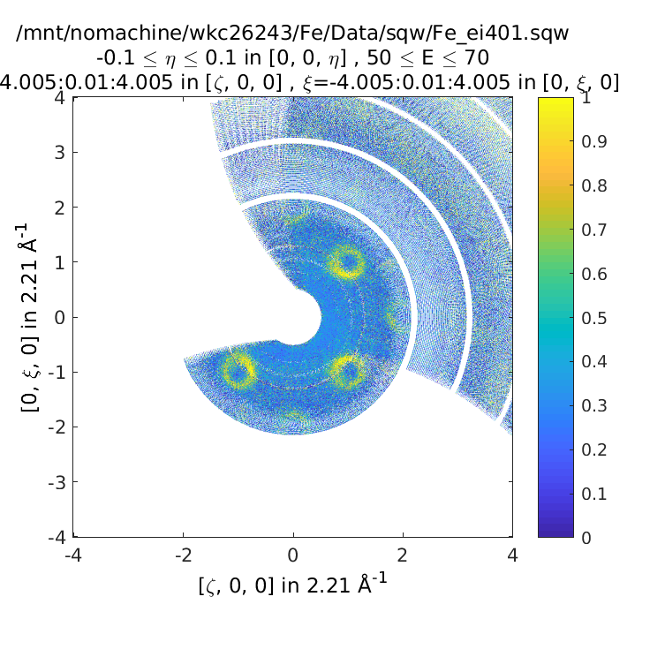
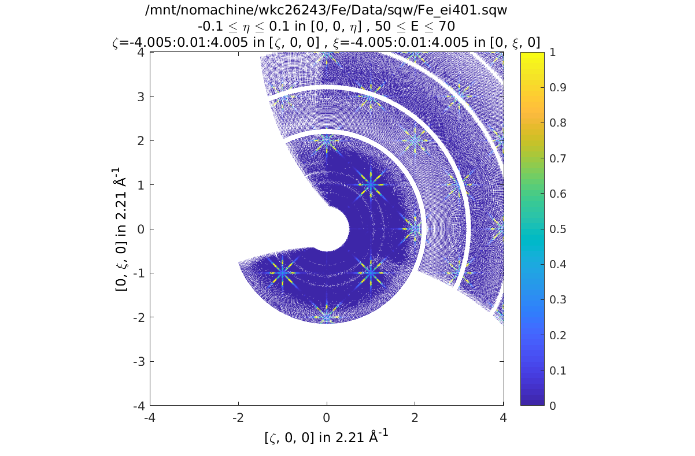
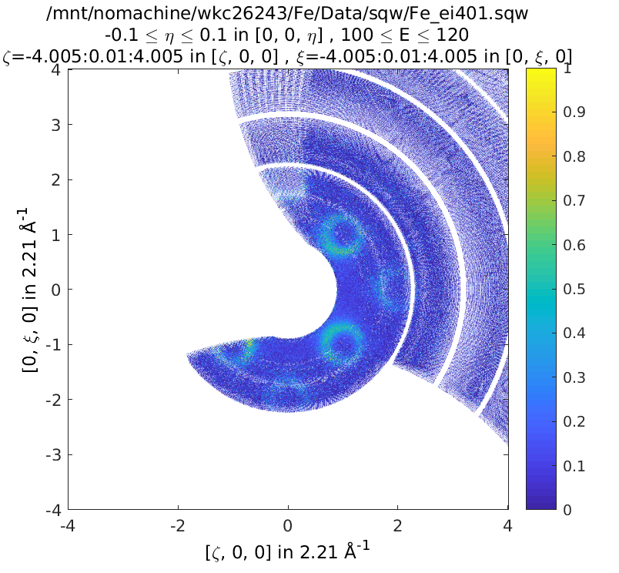
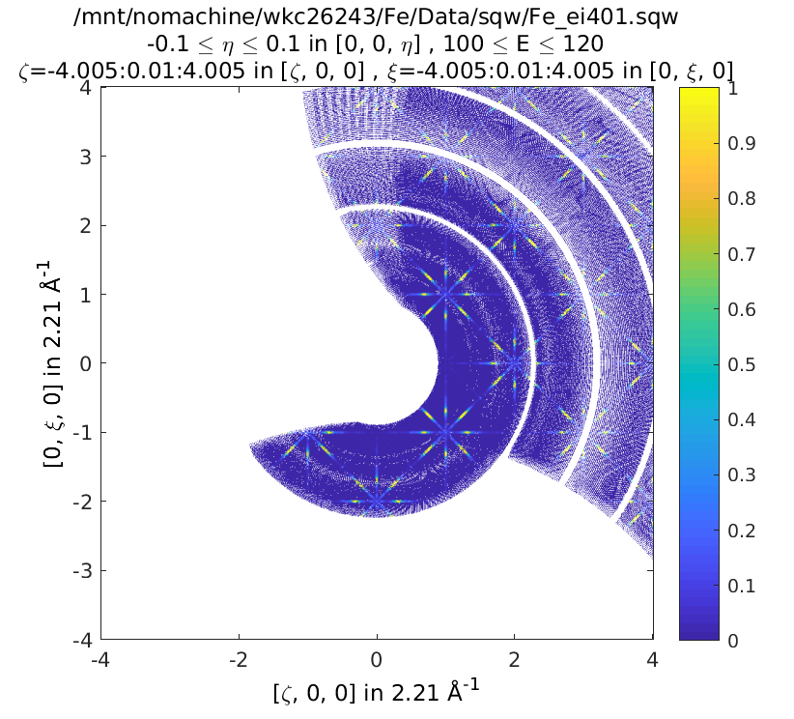
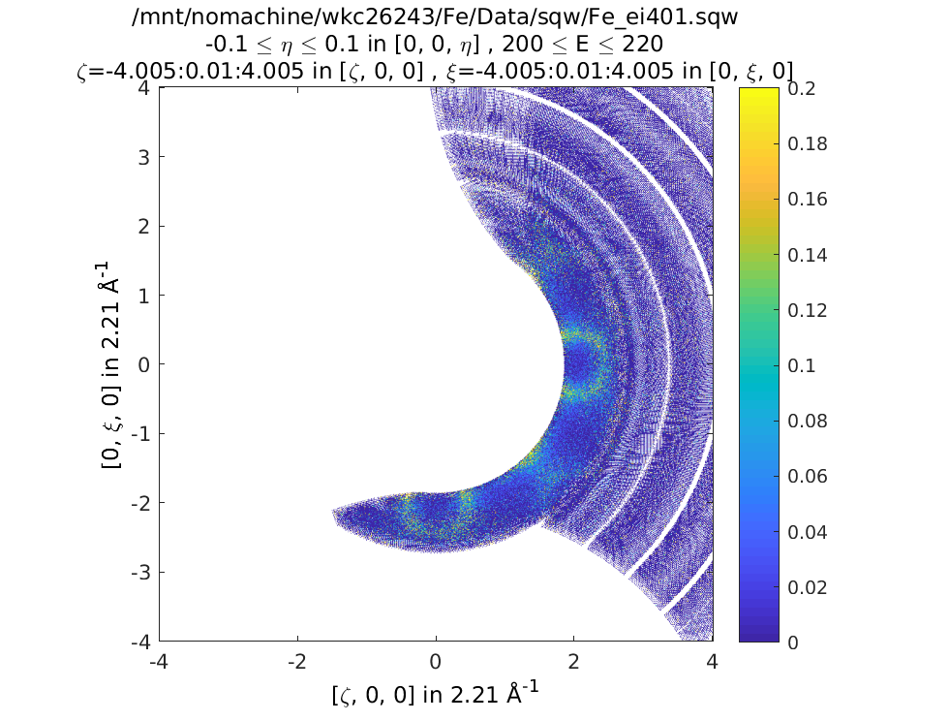
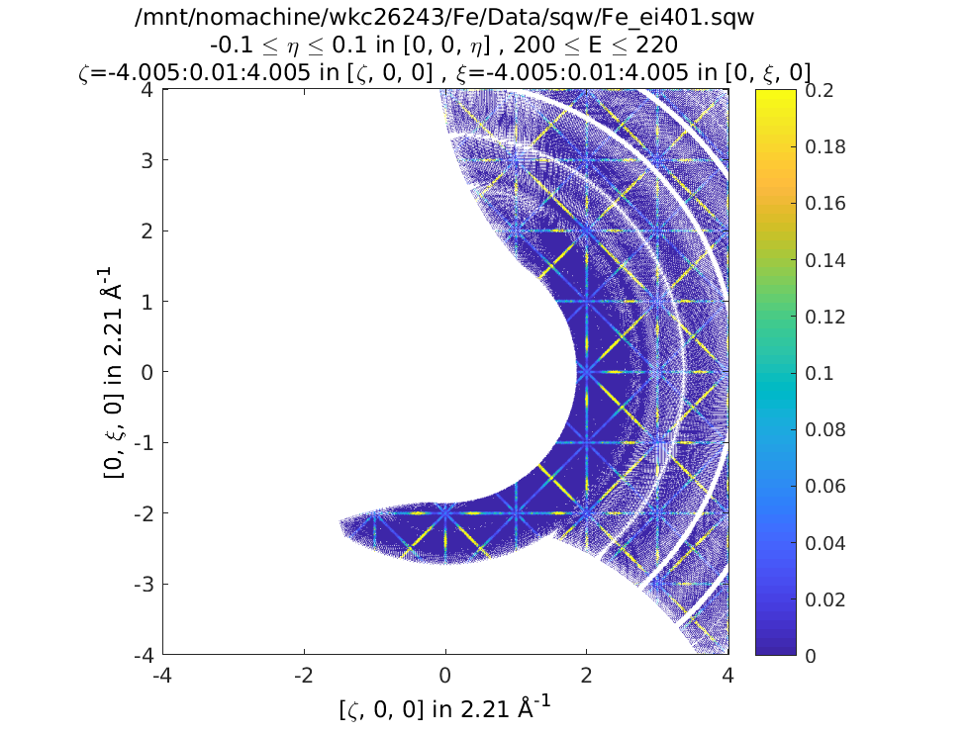

Slide 20
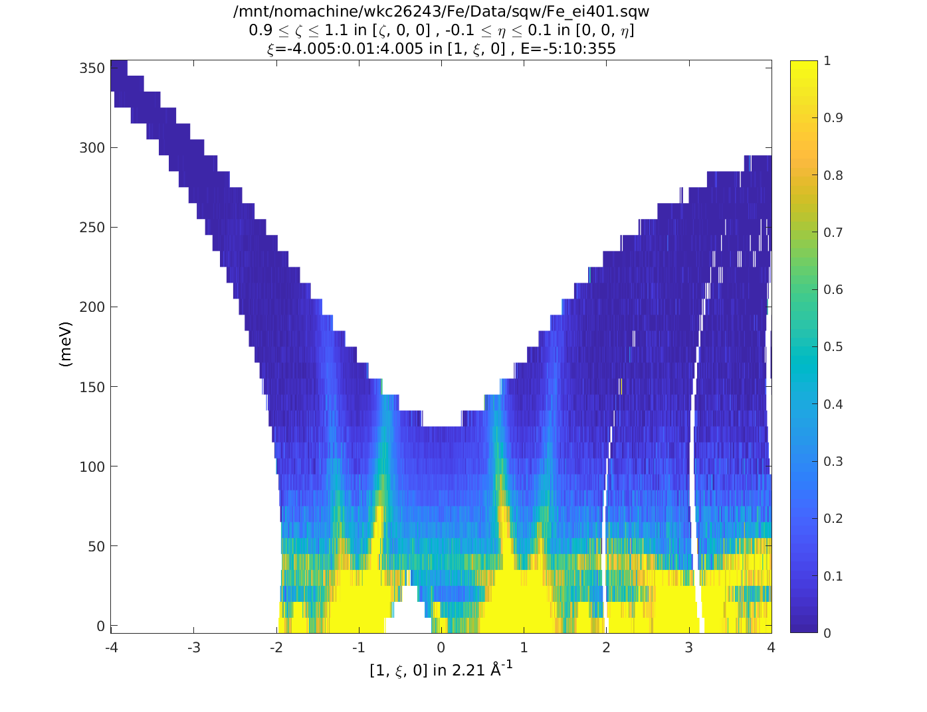
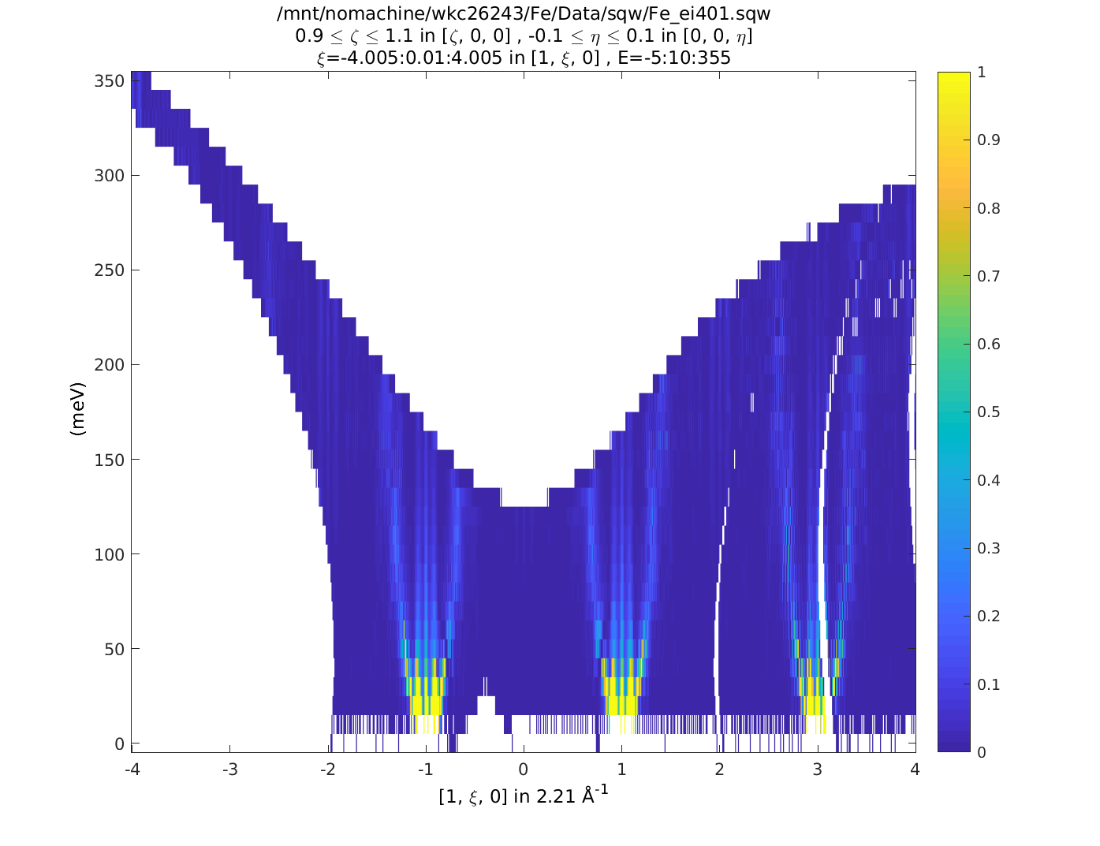
Problems in simulated Kun
Plot contains duplicated high symmetry points

Slide 21
Fitting Kun calculations in 110 direction to experiment varying amplitude and const background
Problem at high energy as experiment catches other directions when theory approximates is only in 110

Slide 22
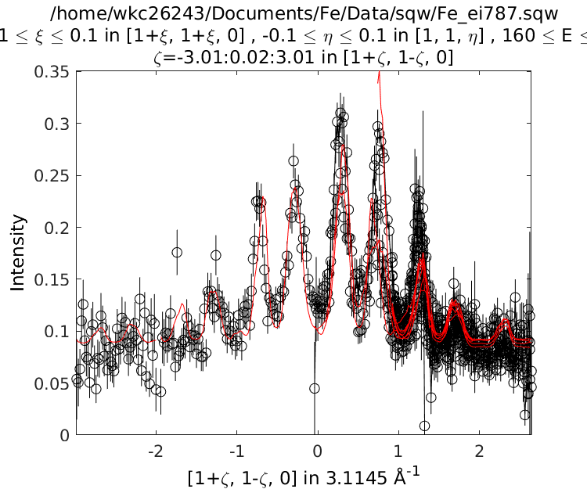
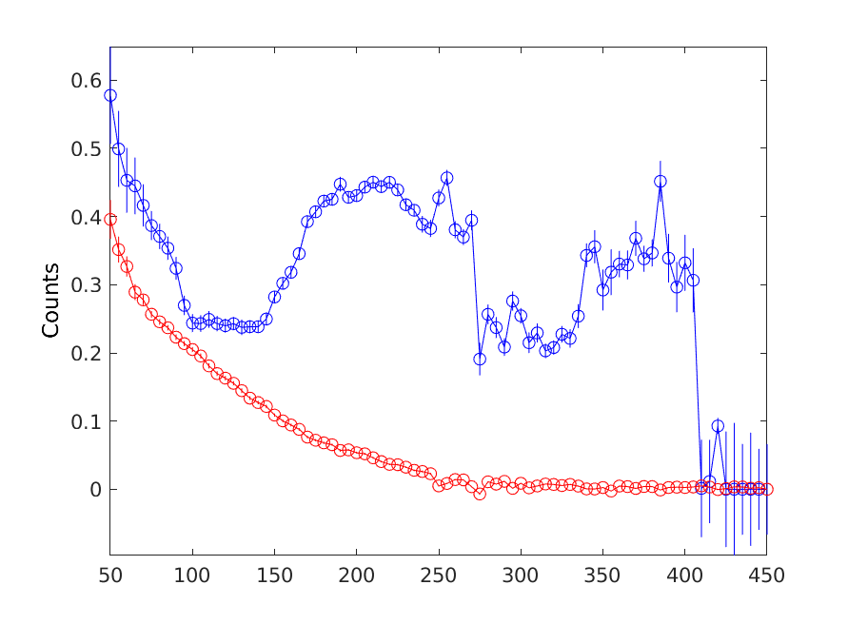
Fitting all directions.
Only first cut’s background
is plotted here
Single direction cut – see above

